Slide 1
Lesson Plans
Student Engagement and Lesson Plan Design

Slide 2
Strategies
Tools
Formative Assessment
Games
Gamification
Virtual Reality
Lesson Plan Design
Know and Emphasize the Principles
Scope Definition

Slide 3
Formative Assessment
Low-tech
Fist to Five
Two-minute Paper
Three, two, one
K-W-L
Student Response Systems
GoSoapbox
Socrative
Kahoot
Notes:
Also called “check for understanding” or “embedded learning assessment”

Slide 4


Clickers

Slide 5
SRS Comparison
 | Kahoot | GoSoapBox | Socrative
One-off questions with ease
Great for competition
Reports and archiving
Clean interface
Multimedia integration
Conclusion | Fun | Clean | Fully Featured

Slide 6
Resource Links
Cybersecurity Games
Cyber Threat Defender – card game
CyberLab – defend your network
Brute Force, Space Scams – passwords and phishing
Learn Programming
CodeAcademy
Code Combat
Code.org
Day of Cyber – cybersecurity expert role-play
Virtual Reality
How-to Presentation – cheap, engaging
Notes:
Also called “check for understanding” or “embedded learning assessment”

Slide 7
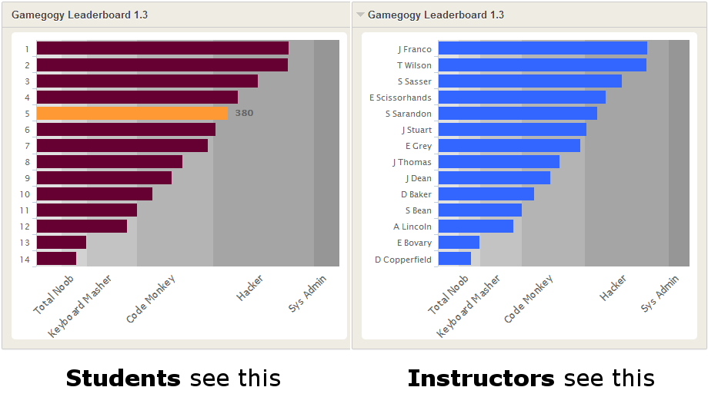
Gamification

Slide 8
Picking the Principles to Cover
Start with just one
Use the cards for inspiration
Develop a narrative
Pick up principles along the way

Slide 9
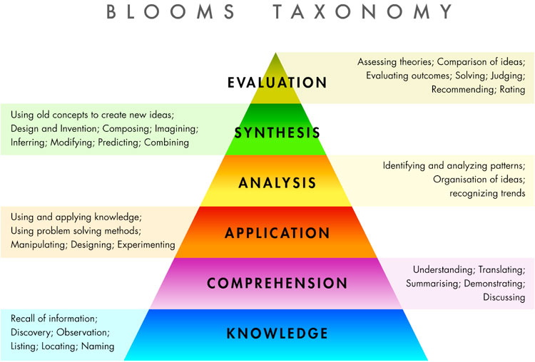
Scope Definition
Shooting for the middle without losing the tails
Bronze (least take-away)
Silver
Gold (advanced application)
Time management
Practice
Asynchronous activities
Notes:
Bloom’s Taxonomy

